Slide 1
Recontextualising Catholic school Religious Education: Educating young people spiritually, morally and religiously for the 21st century

Slide 2

1. The role that school education might have helping young people find meaning, purpose and values in times of rapid social and cultural change;
How the school subject area Religious Education is well placed and well credentialed to make a potentially valuable contribution – especially in the senior school
2. Where does the current trajectory of Australian Catholic school Religious Education stand in relation this role?

Slide 3
We live in times of unprecedented change that make it difficult for young people to find meaning and purpose in life, and there is a need to consider school education might be able to make some contribution to help them in this quest.

Slide 4
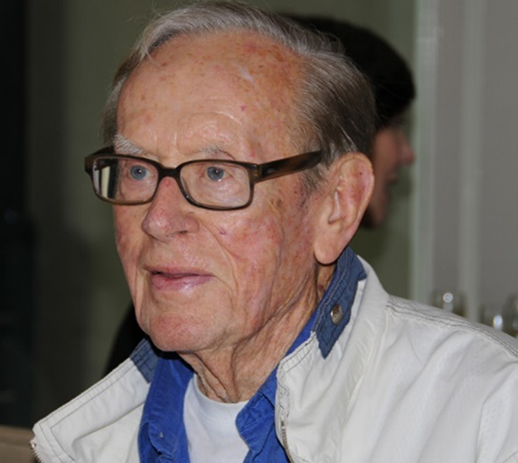
What can we do about the problems? | Charles Birch 1965 “The problems are not out there for us to solve, but to SOLVE US.”

Slide 5
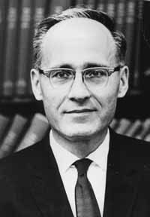
How might school education help? | Philip Phenix 1964 Realms of meaning: A philosophy of the curriculum for general education. Education to include a focus on the construction of meaning, purpose and values

Slide 6
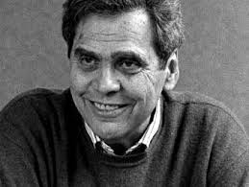
Key role for the school curriculum | Postman (and Weingartner) 1969 No institutions or processes – including schooling –could reliably solve the problems; but education was a good starting point because it could skill young people in critical thinking and research, resourcing their capacity to think about the issues and to make better informed decisions

Slide 7
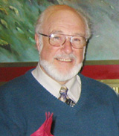
Role of school and Brian Hill 2006 Religious Education Regarding the school: “the mission of education is to resource the choosing self” Regarding religious education in any school “The teaching of religion in school has certain limited but crucial educational purposes: To help students appreciate the importance of the spiritual quest; of working out where they are going as human beings. To help them to interrogate their own cultural conditioning and reach a position of being able to develop an adequate personal framework of meaning and value.” (along with other purposes)

Slide 8
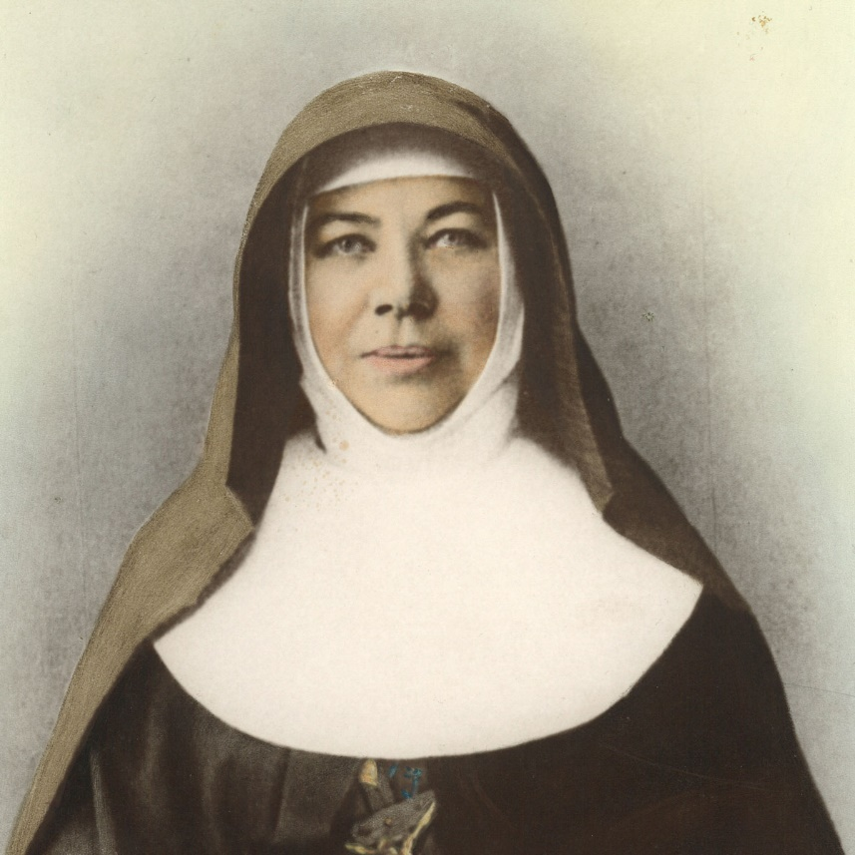
You can’t do everything.
You can’t do nothing.
But you can do something.
Mary- MacKillop
1871

Slide 9
Some historical precedents
1974. Community Development Studies (One of the first NSW Catholic Y11-12 religion courses state accredited as an Other Approved Study).
Broadened the base beyond Catholicism; Tried to address newly arising problems with excessive individualism by focusing on the community context.
Some theological topics (E.g. Christology, Gospel study);
The emerging environmental crisis ( and Limits to Growth, ZPG [Zero Population Growth]);
World religions; Insights from psychology and sociology;
Community integration (E.g. mental health services; the court system of justice; education & integration of the handicapped; care for the homeless);
Intensive live-in PD seminar (Retreat)

Slide 10
Brisbane CEO 2019 Y11-12 Non accredited study
Religion, Meaning and Life
Young people are confronted by the complexities, dilemmas and conflicting interpretations of life’s meaning and purpose. They require, more than ever, the skill of critical thinking in order to navigate an uncertain and pluralistic world.
(At the start of the Rationale statement)

Slide 11
Where does Australian Catholic school Religious Education stand in relation to the role just considered?
Identification of the trajectory in the discourse of Catholic school Religious Education (the language and constructs for articulating purposes and explaining practices)

Slide 12
The discourse of Australian Catholic school Religious Education appears to be on a trajectory described as ‘ecclesiastical drift’
Ecclesiastical drift occurred where the discourse about purposes and practices has gradually and incrementally come to be dominated almost exclusively by ecclesiastical constructs like faith development, faith formation, Catholic identity, new evangelisation and Catholic mission.
When religious education is projected as, and where it is perceived to be, an exclusively ecclesiastical activity and not an educational one (a church activity, not a school one) students, parents and teachers tend to see RE as not an integral part of the curriculum, but a nominal requirement of Catholic school authorities which has little relevance to young people’s education and personal lives.

Slide 13
Excessive use of church language, at the expense of the word education:-
Turns the focus ‘inwards’ towards Catholicism – at the very time when more of an ‘outwards’ focus on the shaping influence of culture is needed.
Is perceived as trying to get young people back into the Church.
Obscures the educational dimension to RE. What suffers is thinking about what it means to educate today’s young people spiritually and religiously.
Both academic status and perceived relevance of RE are eroded.

Slide 14
While there have never been more theologically well-qualified religion teachers in Catholic schools, ecclesiastical drift seems to have resulted in some waning in morale, teaching satisfaction, and creativity – especially at the secondary level. RE teachers more readily seen as the ‘God Squad’.
Can endanger the justification for government funding of Catholic schools by projecting RE as an ecclesiastical and not an educational activity ( c/f contravening Section 116 of the constitution; challenged in the Defence of Government Schools High Court case 1978-1981)

Slide 15
Some indications of ecclesiastical drift
Diocesan Director of Catholic schools, 1987: What we need is faith formation and not religious education
Bishop, chair of Episcopal Committee for Education, 2016:
My concern has not been with [religious education] curriculum issues, but more with faith formation programs, seeking to know “what works”.
Literature tuned in to ecclesiastical drift. 2019:
Advertisement of New book on Catholic mission in education. Learn how to put the Catholic back into Catholic schools.
Title of new book on Catholic schooling An Educator’s Guide to Mission in Practice: Discipleship in Action in Catholic Schools
New draft RE syllabus, 2019 Studies in Catholic Thought: The word ‘Catholic’ is used 538 times, while the word ‘religion’ appears 9 times.
2020 Teacher education and professional development: The terminology has changed to Faith formation for the mission of Catholic identity

Slide 16
The names of Diocesan Catholic Education Office RE Departments have changed in recent years. Some examples:
Evangelisation and Catholic formation
Catholic Mission & Identity
Enhancing Catholic School Identity
Catholic Identity and Religious Education
Religious Education and Evangelisation
Department of Mission
Catholic Life, Education and Mission
Identity, Mission and Religious Education
Faith Education and Formation
Learning, Teaching and Catholic Identity
Faith and Life
Catholic life and Mission
Faith Education and Learning
Religious Education and Spirituality
Mission and Evangelisation
Catholic Identity
Identity and Mission
Catholic Identity and Evangelisation
Identity and Liberating Education

Slide 17
USE OF THE CONSTRUCT FAITH FORMATION SINCE THE mid 1980s
Why is faith formation been chosen to replace religious education as a favoured term?
How could an independent observer tell when an activity was faith formation or just education?
If the meanings of the words ‘faith’ and ‘formation’ are teased out in detail, does the phrase faith formation become very problematical when used to replace religious education?

Slide 18
USE OF THE CONSTRUCT CATHOLIC IDENTITY SINCE THE
mid 1990s
First appeared in the Australian journal Word in Life/Journal of Religious Education in 1997 (36 articles referred to it since then up to 2013)
What was said in this article about the complexity of the nature and development of personal identity, and about the possibilities and limitations of a school for helping foster a sense of religious identity seem to be just as relevant today as they were in 1997.
The impulse driving the growing concern about Catholicity or Catholic identity derived mainly from conservative groups like Catholics concerned for the Faith going back to the mid 1970s – Poor Religious Education in Catholic schools was blamed as the main cause of the decline in Church engagement.

Slide 19
This ‘first impulse’ driving concerns about the Catholic identity of schools is still evident to varying degrees in different parts of the Catholic sector
(From AD 2000 Journal 2015)
We firmly believe that the Church has a major problem with its delivery of religious education in her school system and think that urgent action is required to improve her performance.
. . . .there is something drastically wrong with the curriculum and the way it is being taught.
Etc.

Slide 20
The ‘second impulse’ driving contemporary concern about Catholic identity of schools
The Enhancing Catholic School Identity Project, 2005 --
The recontextualising agenda proposed by Belgian theologian Lieven Boeve.
The interruptions to the way traditions are handed on from generation to generation are opportunities for Christianity, and theology in particular, to re-contextualise and re-orient their endeavours to dialogue critically and constructively with culture to address the spiritual needs of the new situation.

Slide 21
Boeve’s reconextualisation is continuous with ‘Reading the signs of the times’ coming from Pope John XXXIII and Religious Orders in the mid 1960s.
Efforts to help make Catholic RE more meaningful and relevant since that time are examples of RECONTEXTUALISING RELIGIOUS EDUCATION
(Not the same as recontextualising the Catholic Church, Catholic bishops & clergy, and Catholic schools)

Slide 22
Ecclesiastical drift language tends to come across like slogans /cliches for Catholic schooling and Religious Education
What would it look like if other Catholic-State partnership institutions were to demonstrate ecclesiastical drift in their purposes and practice?

Slide 23


Slide 24
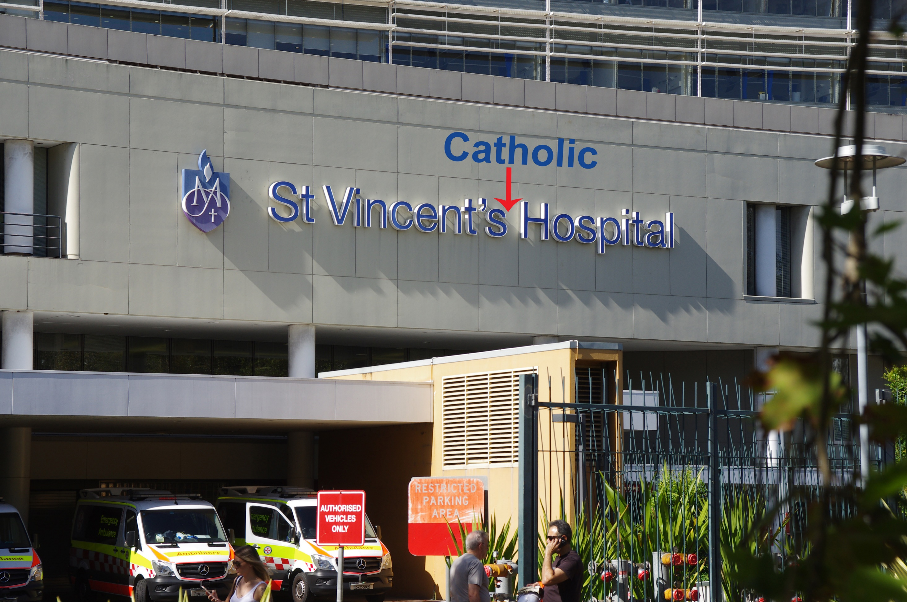

Slide 25


Slide 26


Slide 27
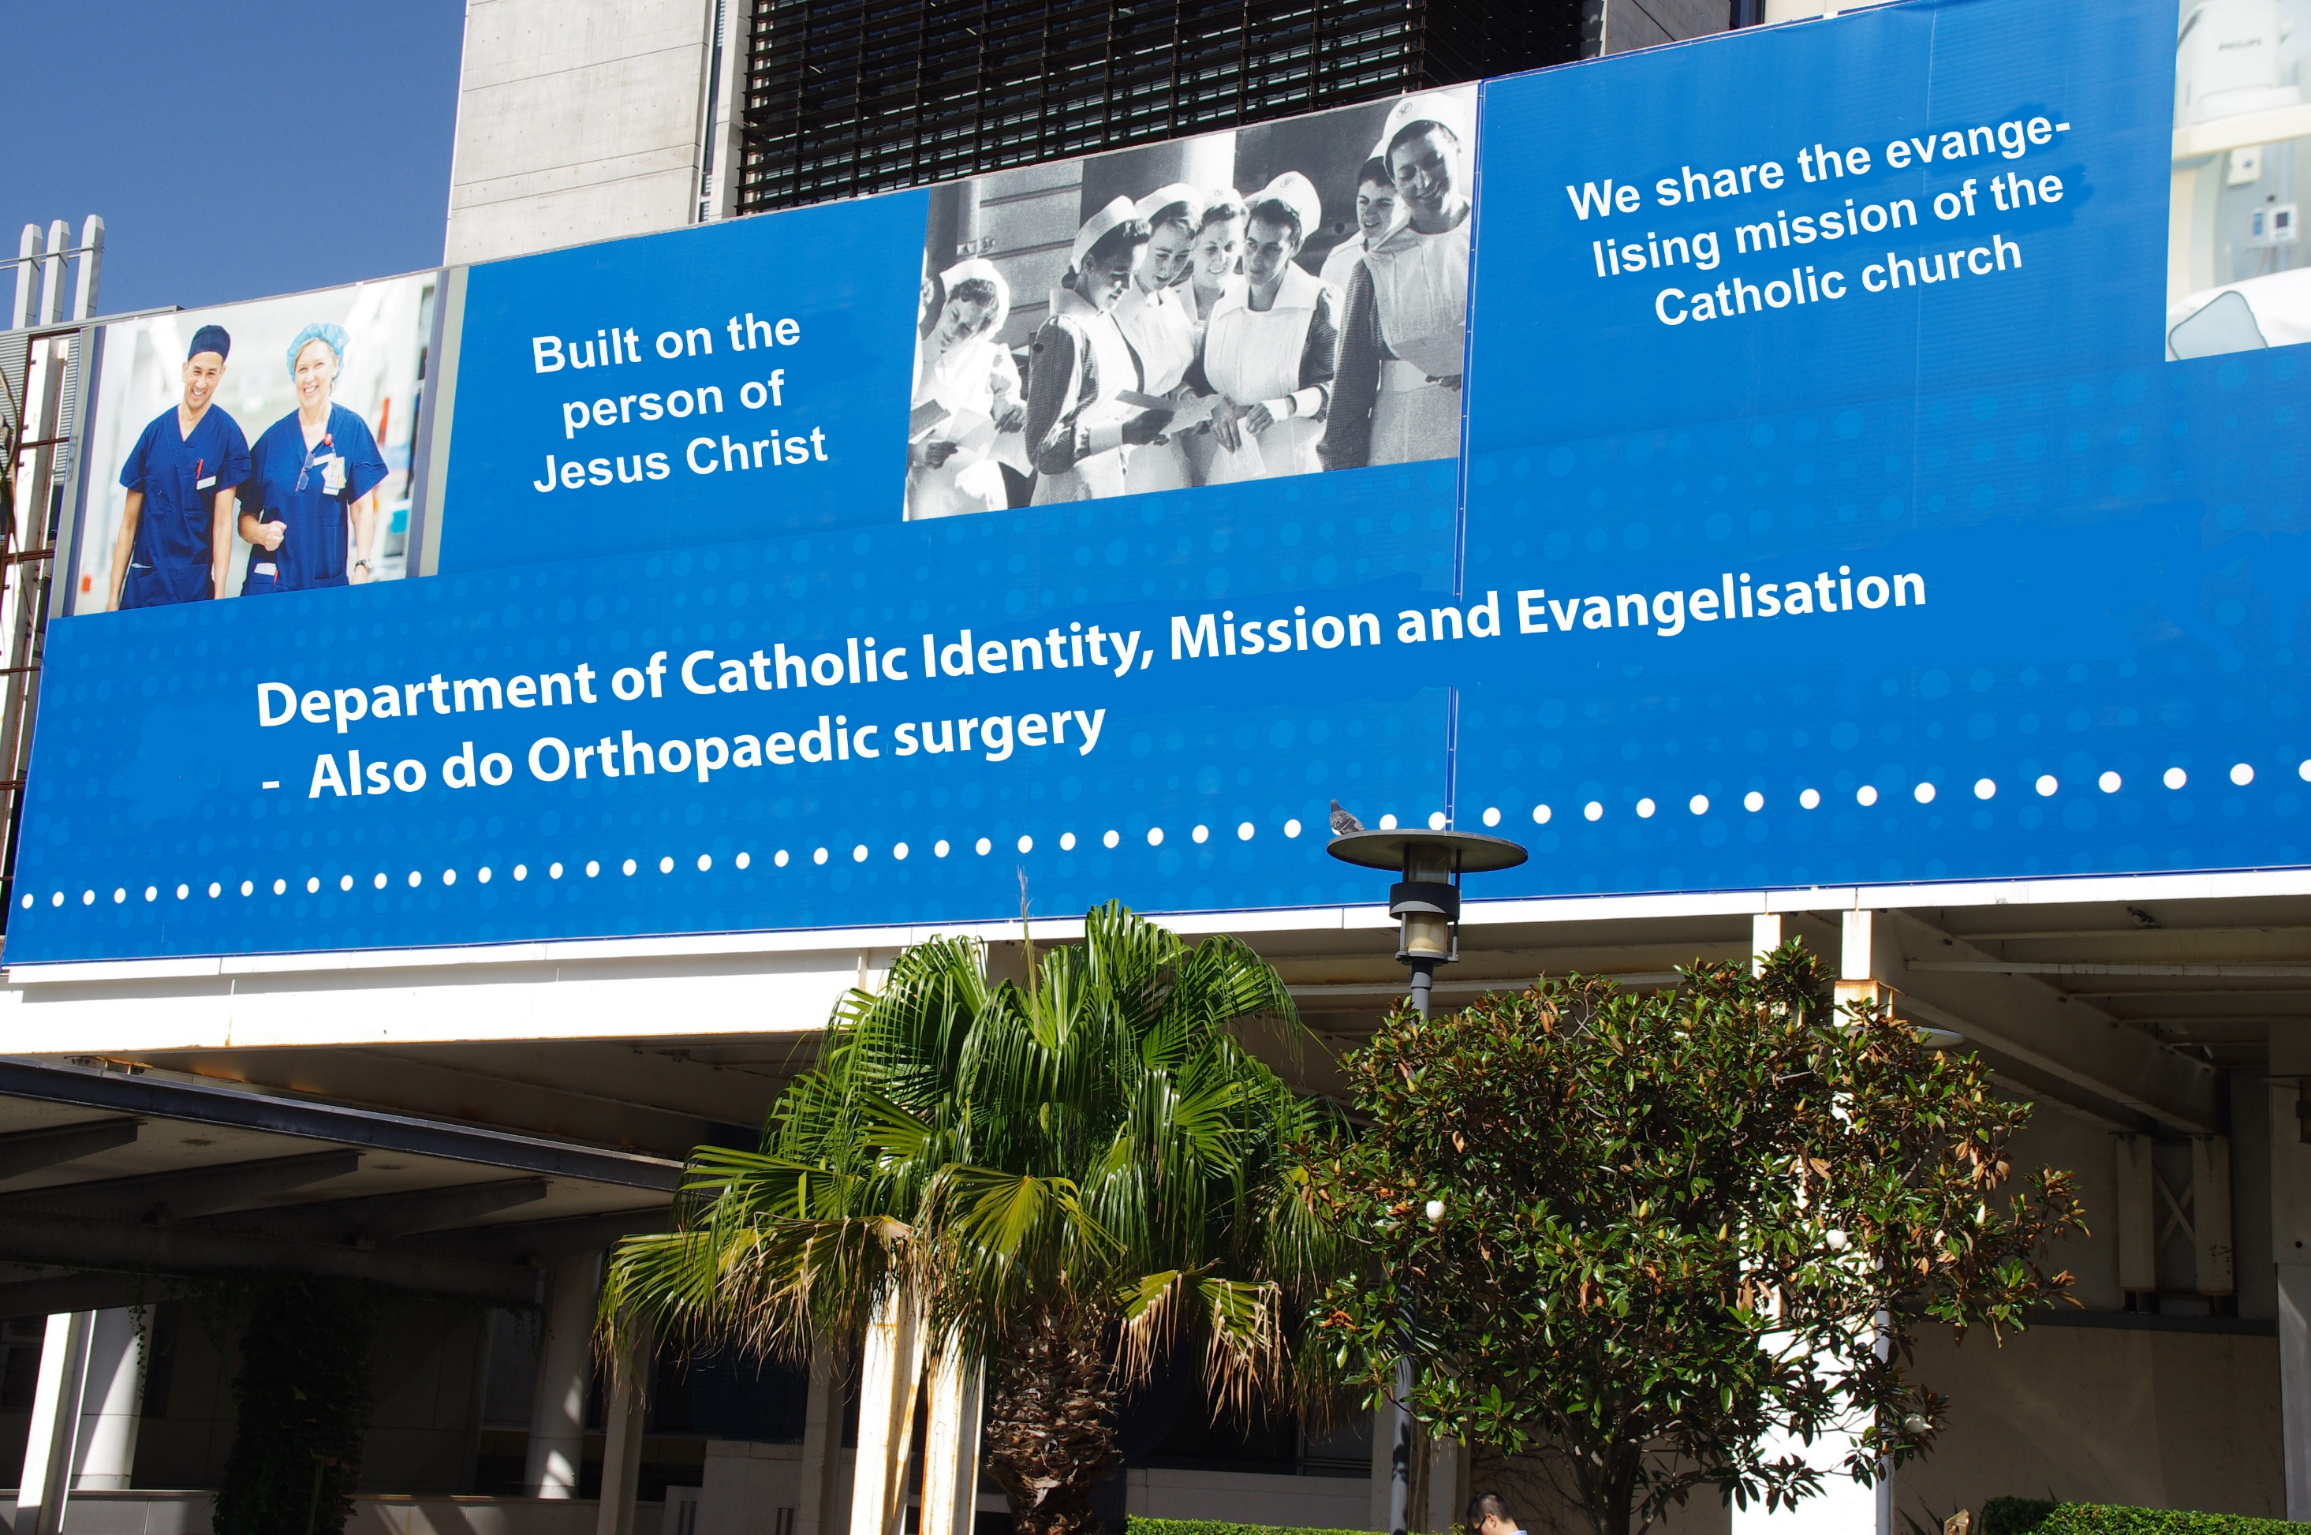

Slide 28


Slide 29


Slide 30
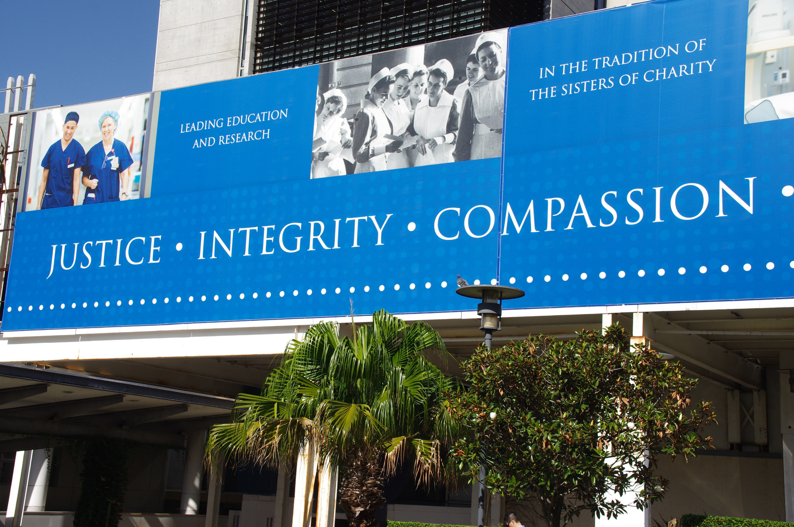

Slide 31


Slide 32
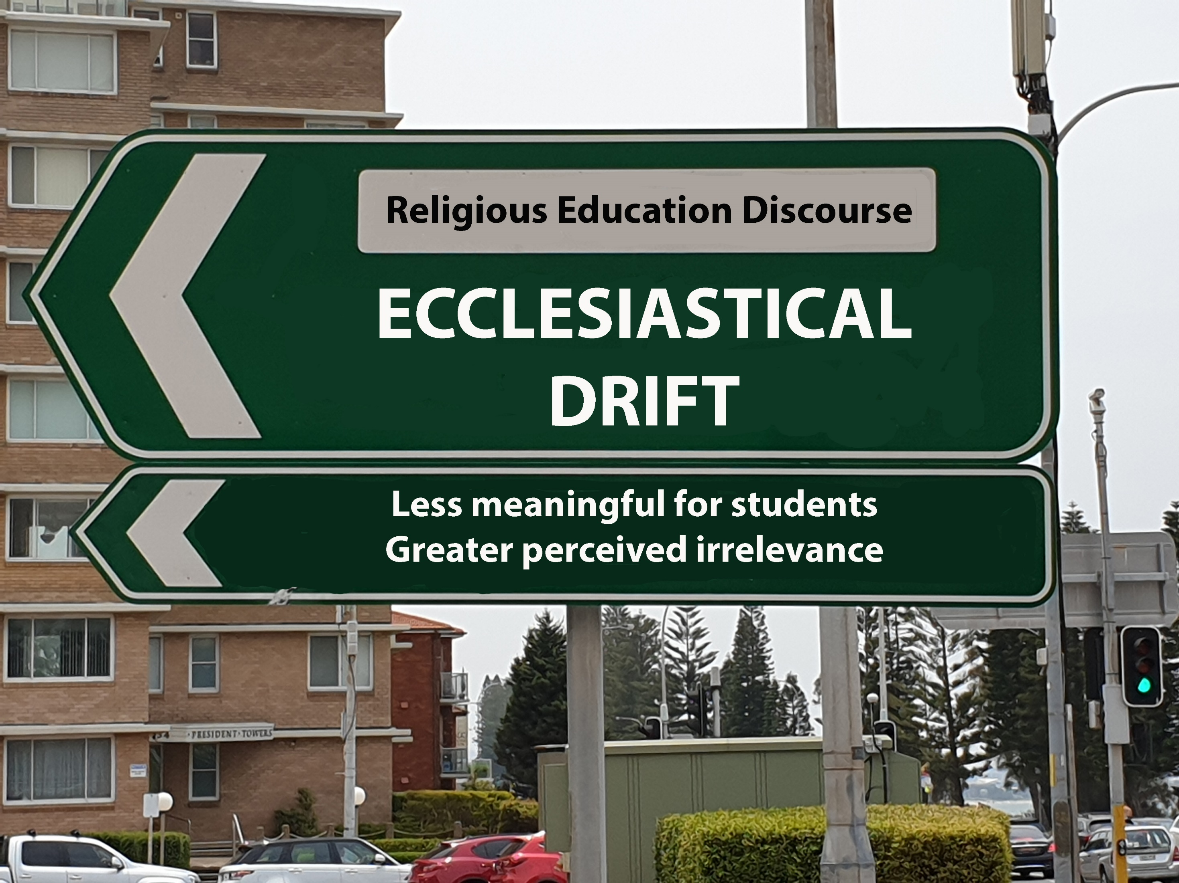

Slide 33
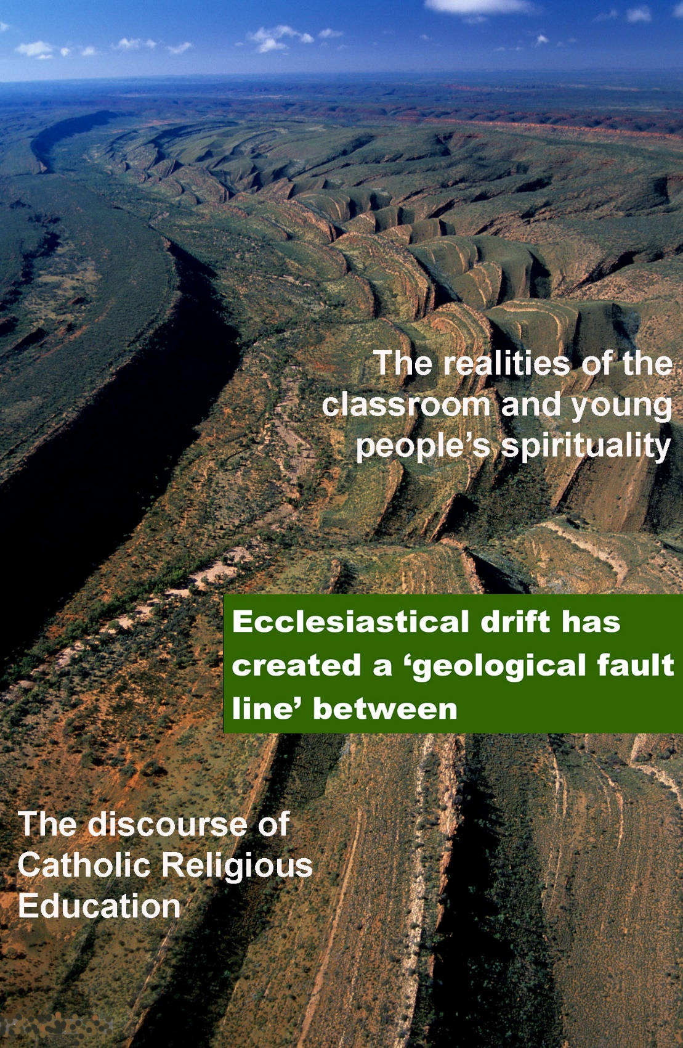

Slide 34


Slide 35
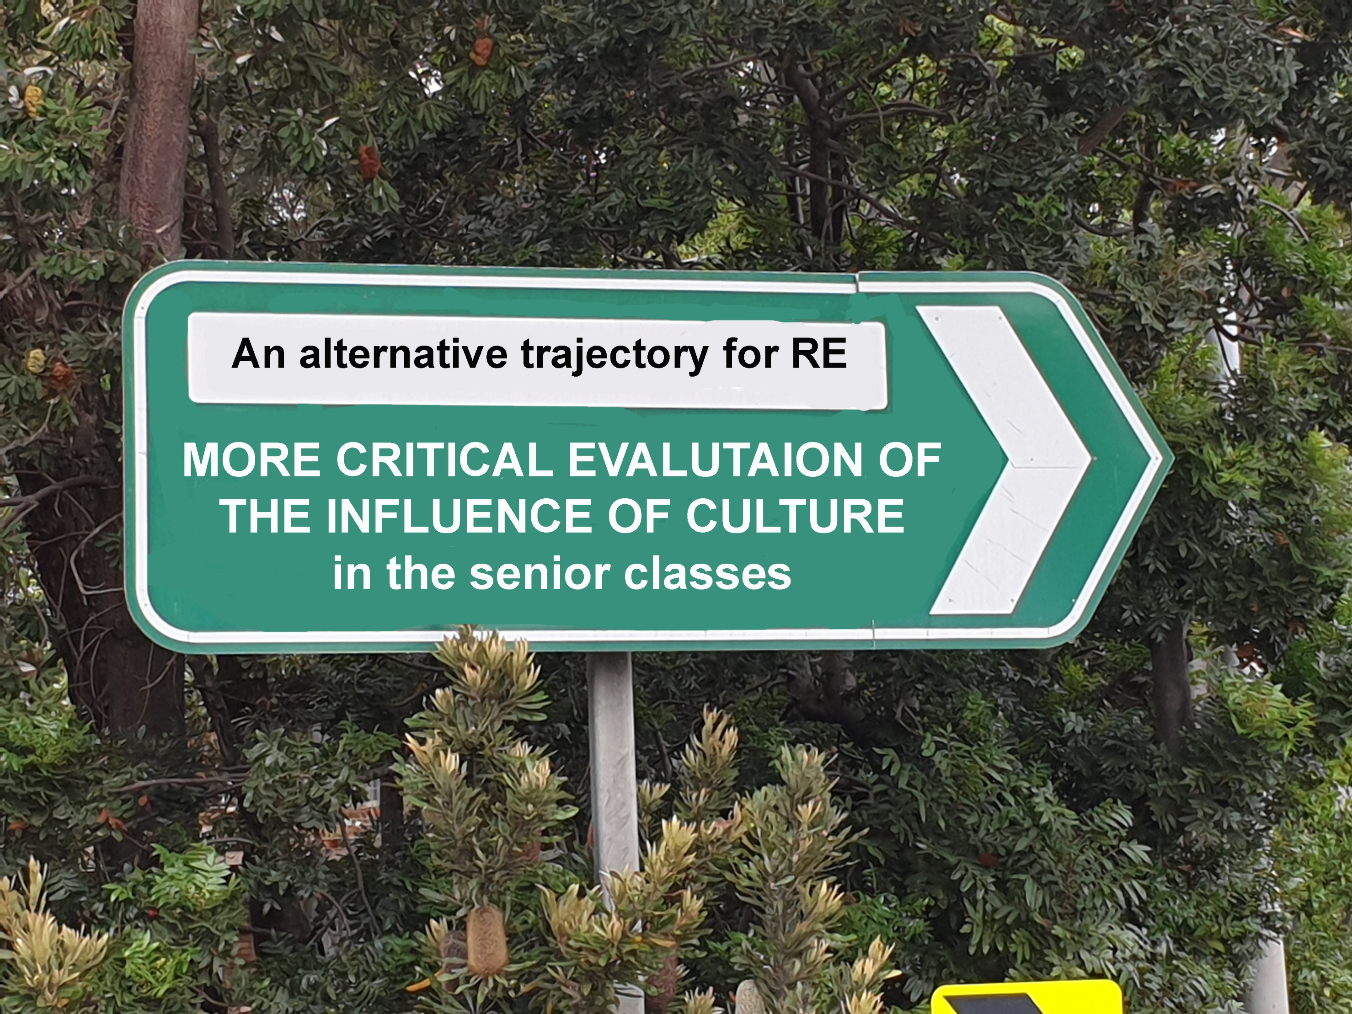

Slide 36
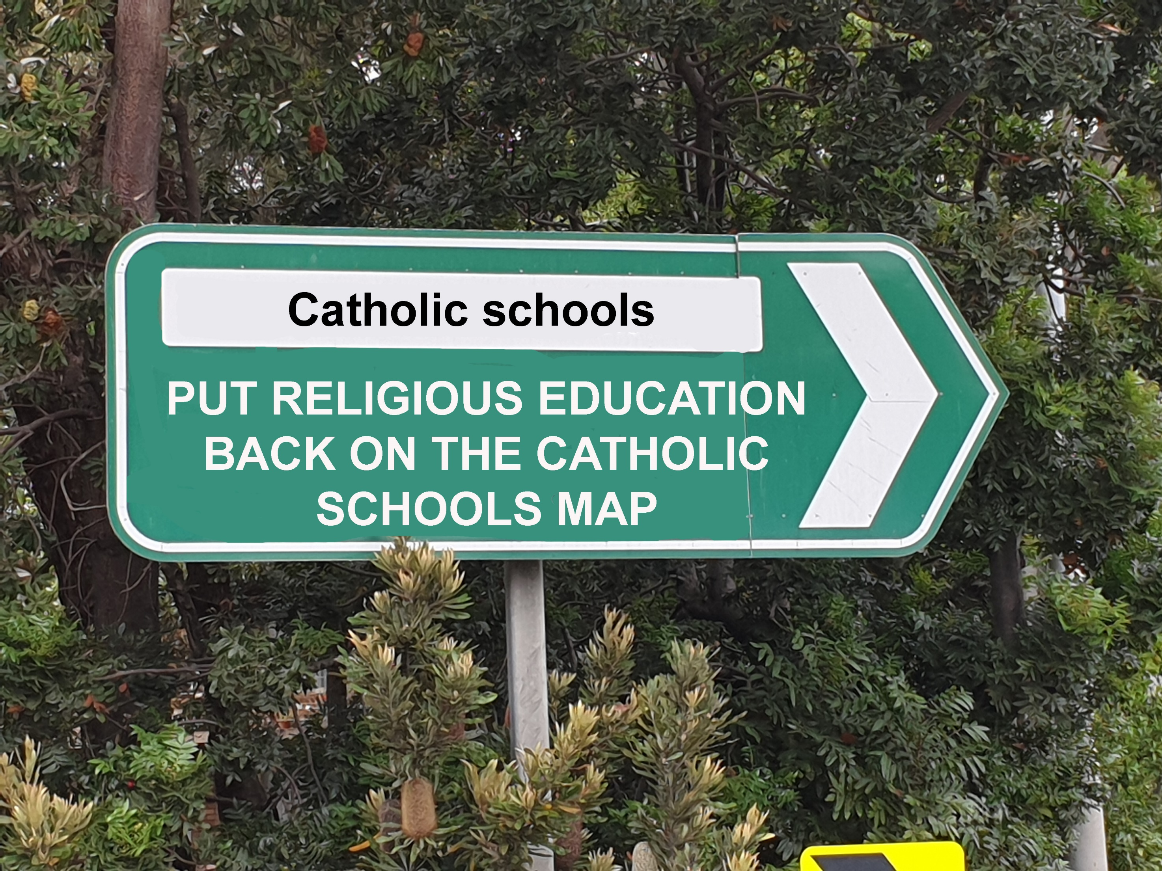

Slide 37
Some other issues taken up in the full paper and appendices to the powerpoint presentation
Evidence of ecclesiastical drift in RE in Australian Catholic tertiary institutions
How extensive is ecclesiastical drift in Catholic schools in other countries?
Comments from Pope Francis and German Archbishop Kohlgraf that are pertinent to interpreting the problem of ecclesiastical drift
An example of how to start addressing the problem by changing the discourse of Catholic school Religious Education

Slide 38
The influence of ecclesiastical drift on religious education in Catholic tertiary institutions
Some Religious Education staff at tertiary level have contributed to the growth of ecclesiastical drift in the discourse of Catholic school Religious education
Some of the negative effects have been even more structurally noticeable than in Catholic schools – such that in some instances it looks more like ‘direct action’ rather than ‘drift’.
(See the full paper for a discussion of this question)

Slide 39
How extensive is Catholic ecclesiastical drift in other countries?
Some indications of ecclesiastical drift in Catholic Religious Education have been identified by colleagues in the United Kingdom, Ireland, Europe, USA, Canada and New Zealand.
They noted modulations in the problem depending on differences in context (E.g. Publically funded or private catholic schools, availability of government accredited religion studies courses. Also in Lutheran Church programs in Norway)
E.g. Europe: “The longing for reconfessionalisation (even in the form of a hidden recontextualisation) is everywhere”.
UK and USA: Two scholars independently suggested that the title ‘ecclesiastical drift’ was too soft. They recommended a more confrontative description “Intentional ecclesiastical restorationism”

Slide 40
Pope Francis I: Negative comment about Restorationism and implied endorsemen of Recontextualisation
If the Christian is a restorationist, a legalist, if he wants everything clear and safe, then he will find nothing. Tradition and memory of the past must help us to have the courage to open up new areas to God. . . . those who stubbornly try to recover a past that no longer exists – they have a static and inward-directed view of things. (Pope Francis I, 2013, pp. 8, 11).

Slide 41
Archbishop Kohlgraf (Mainz Germany) seems to be addressing ecclesiastical drift as a pastoral problem (2019)
He said that the term evangelisation had become a “battle cry” or slogan when used ubiquitously without relevance to the wider world. This tended to cripple the discourse about a contemporary, meaningful faith because it created a gulf between the church’s narrative and the reality of people’s daily lives.
He was also concerned that when ecclesiastical terms became clichés/slogans, the real issues to be faced tended to be ‘trivialised’

Slide 42
An example of how to address the problem of ecclesiastical drift in the discourse of Catholic Religious Education
Examples of ecclesiastical drift problems are shown where it is the exclusive way of articulating the purposes of religious education | Adding complementary, compensating educational statements that are more educational, less Catholic-centric and more concerned with pupils’ personal development. (Where the cultural context is complex and troublesome)

Slide 43
The Catholic school is founded on the person of Jesus Christ
The Catholic school within the community of believers integrates faith with life, and faith with culture.
The Catholic school shares in the evangelising mission of the Catholic church.
The partnership between the Church, Government and Parents enables Catholic schools to make a significant contribution to the education of young Australians
Catholic schools have always given special attention to the spiritual, moral and religious dimensions of education and provide leadership in this domain for Australian school education
Catholic schools educate young people spiritually, morally and religiously for life in the 21st century.

Slide 44
Catholic schools exist so that there can be places where the whole effort of education is conducted in, permeated by, shot through with that understanding of the world which places God at the heart of everything (Bishop’s statement for the Episcopal Committee for Education, 2017)
The Catholic school is a centre of New Evangelisation
The Catholic school helps children to love and serve Jesus
Catholic school religious education helps young people learn how to negotiate a meaningful life through the challenging maze of contemporary culture.
Religious education is a curriculum area where young people can learn how to evaluate critically the shaping influence of culture
Religious education gives young people access to their religious heritage and it resources their spirituality with skills for their search for meaning and values in life.

Slide 45
There is a need to recontextualise Catholic school religious education to better educate young people spiritually, morally and religiously for the 21st century.
Catholic school religious education educates young people in the Catholic religious tradition.
It also informs them about other religions that are prominent in the culture
It helps skill young people in appraising the way culture can have a shaping influence on people’s thinking and behavior.
Religious education can help them better understand something of the complexities of contemporary culture and this may in turn help them in their task of charting a meaningful pathway through life, no matter what their religious disposition or level of religious practice.

