Slide 1
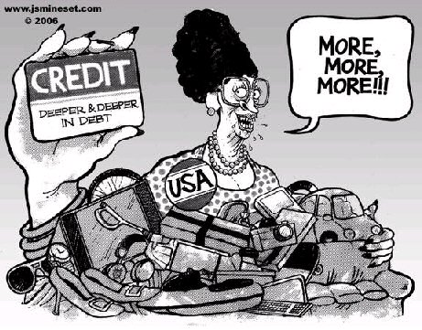
CONSUMERISM
THE DRIVING FORCE OF WESTERNISED CULTURES

Slide 2
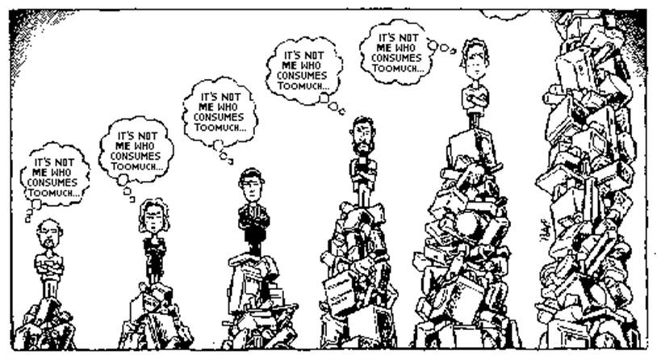
CONSUMERISM:
Consumerism characterises Western Societies:
That is, people consume unnecessary resources for the sake of pleasure.

Slide 3

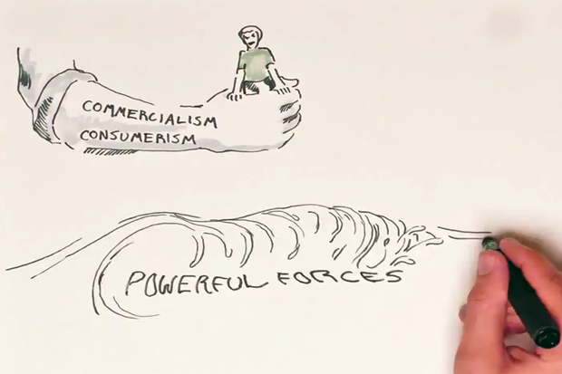
Impacts of Consumerism
The High Price of Materialism
You Tube Clip: The High Price of Materialism

Slide 4
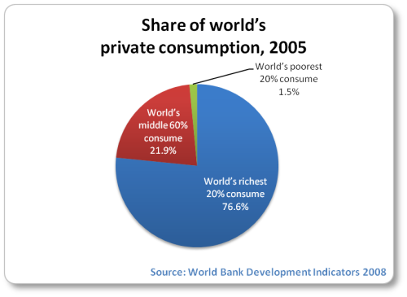

Slide 5
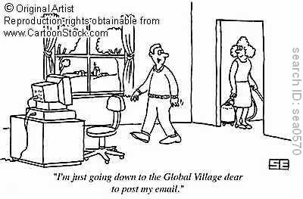
Technology has shrunk the world to a global village

Slide 6
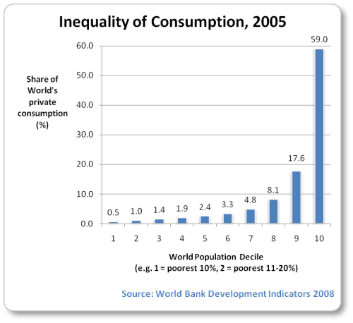

Slide 7
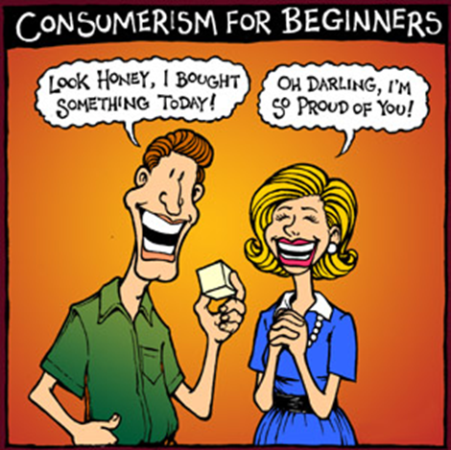
Consumerism is not simply consuming, it is a way of life.

Slide 8

Does Consumerism = Happiness?
Consumerism can be a confusion of needs and wants. It is a never ending quest to satisfy our needs.

Slide 9

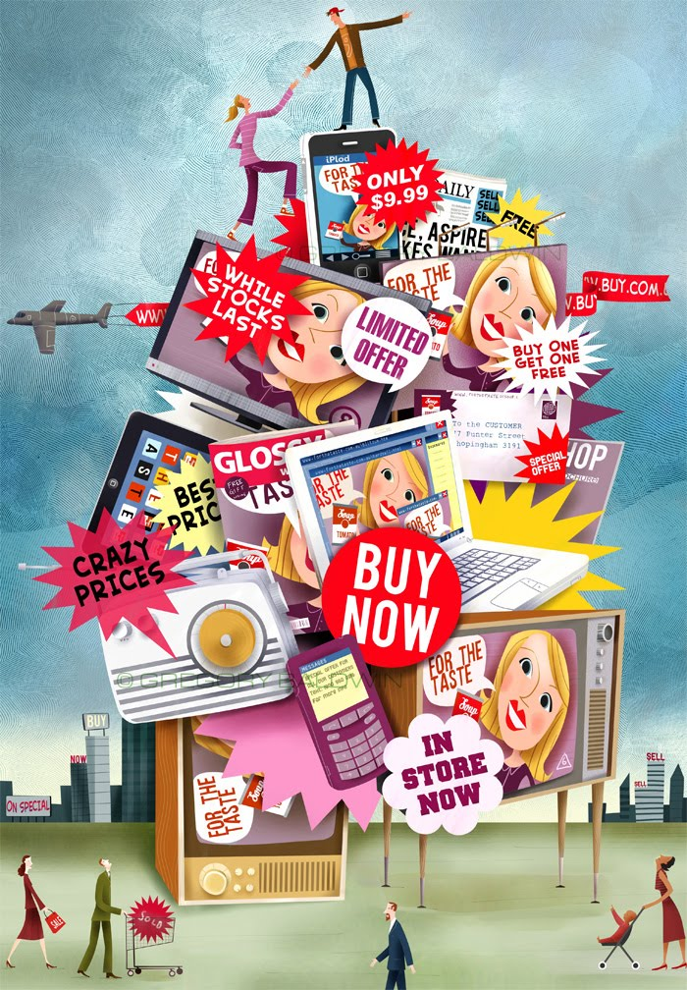
The POWER of Advertising and Marketing
Everywhere we go, everywhere we look, we are inundated with messages.

Slide 10
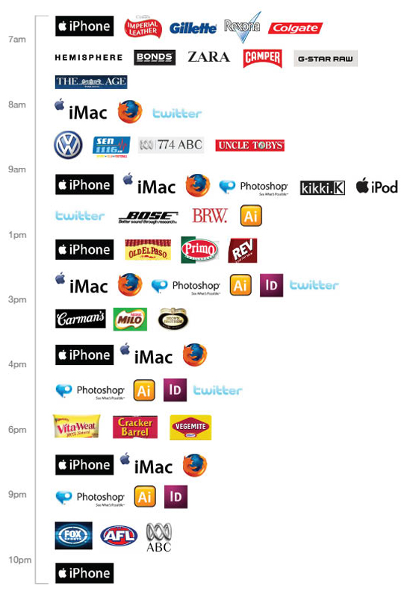
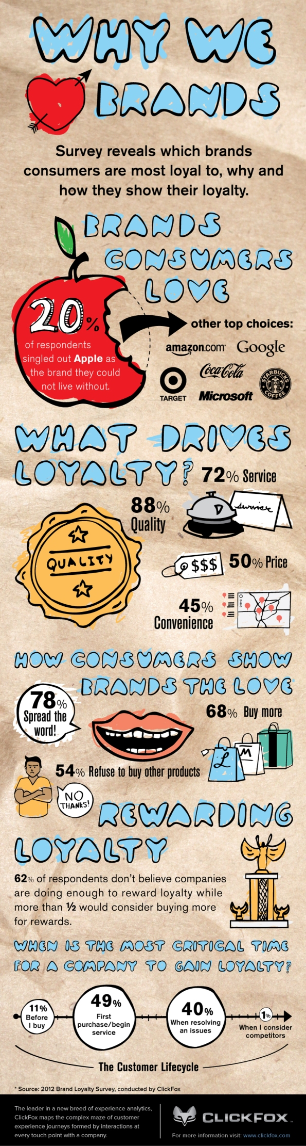

Slide 11
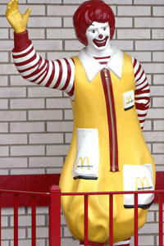
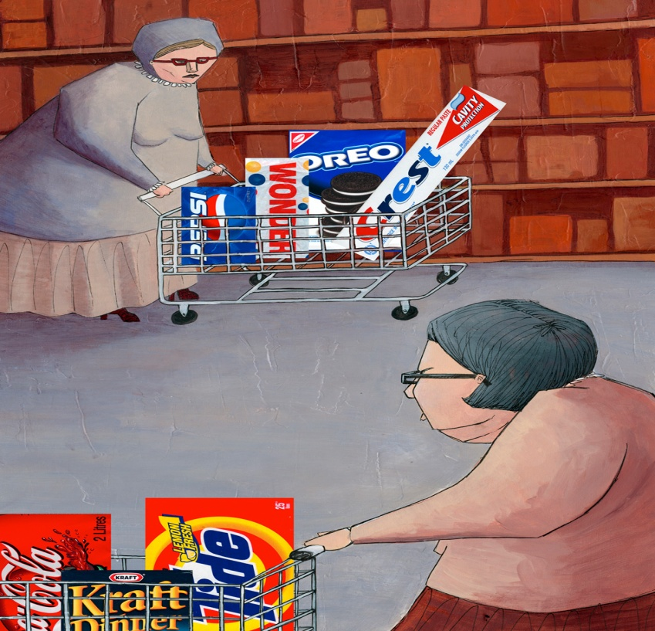
BRAND LOYALTY
Loyal customers will consistently purchase products from their preferred brands, regardless of convenience or price. Companies will often use different marketing strategies to cultivate loyal customers, loyalty programs, trials, incentives, samples and free gifts.

Slide 12
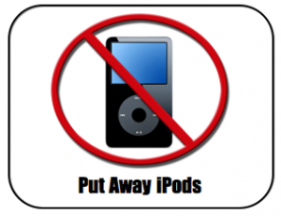



25 years ago

Slide 13
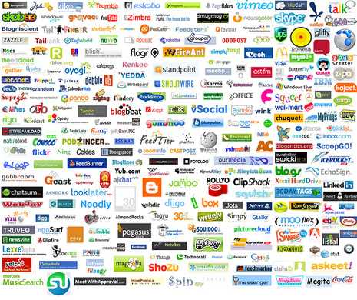
Online social networking

Slide 14
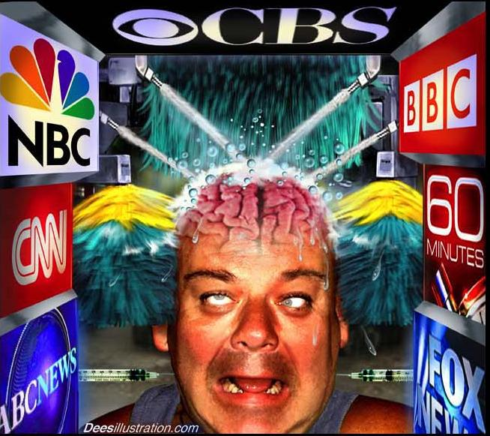
Media = Brainwashing

Slide 15
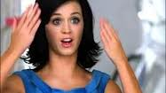
Celebrity Promotions
You Tube: Katy Perry's Skin Care Secret - Get Free Proactiv Sample Here!

Slide 16
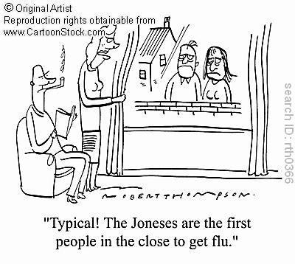
Social trends
Incomes have risen and expectations have risen at the same time. ‘keeping up with the Jones’

Slide 17

Movie advertising
You Tube:
Product Placement in TV/Film/Games

Slide 18
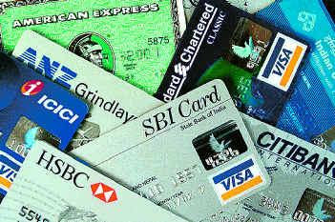
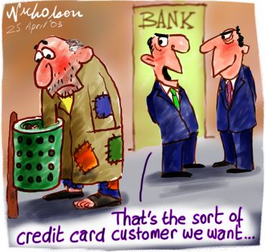
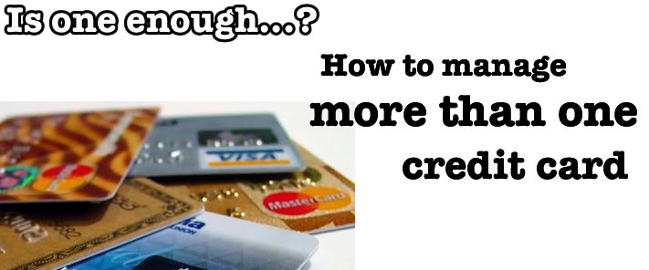
Plastic cash

Slide 19
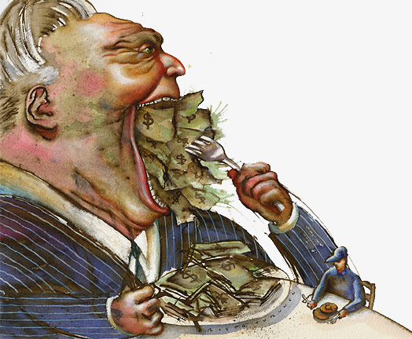

Self centred crime driven by personal greed

Slide 20
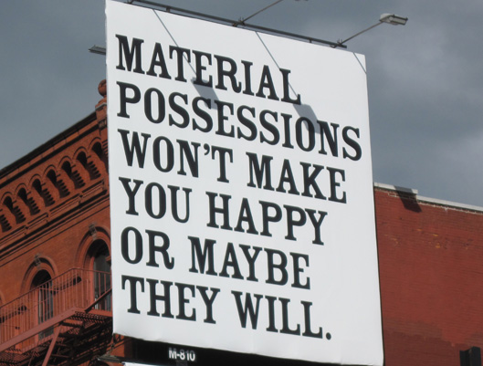
Material possessions are more valued than human virtues.

Slide 21
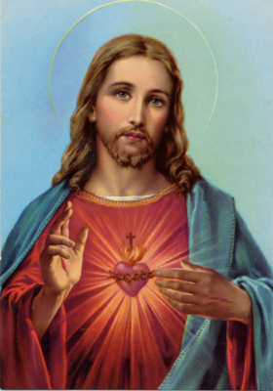
What does Jesus have to say about Consumerism?
Matthew 6:28-34
²⁸ “And why do you worry about clothes? .... . ‘What shall we eat?’ or ‘What shall we drink?’ or ‘What shall we wear?’ But seek first his kingdom and his righteousness, and all these things will be given to you as well......do not worry about tomorrow, for tomorrow will worry about itself. Each day has enough trouble of its own.

Slide 22
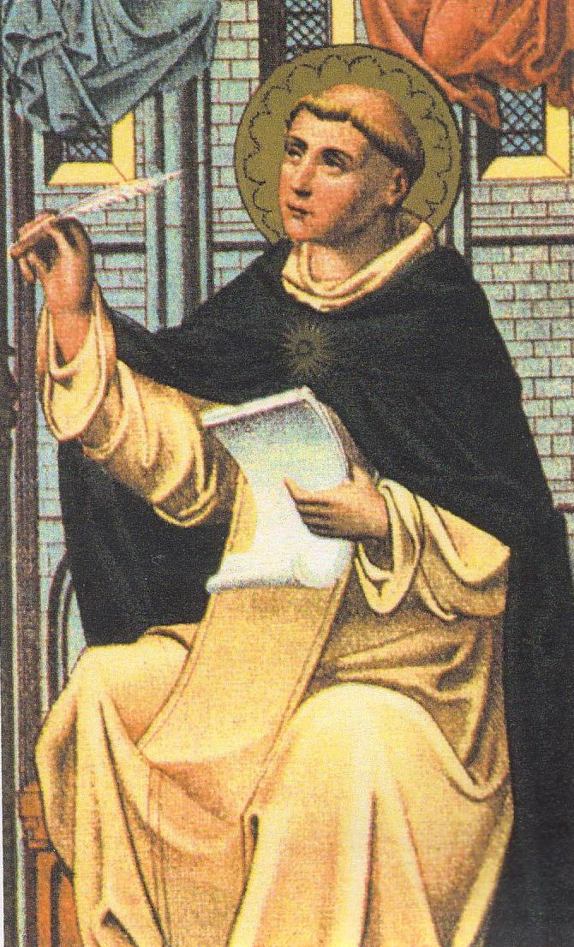
What does Saint Thomas Aquinas have to say?
“man’s apparently infinite desire for riches is disordered and wholly different from our infinite desire for God. The more we possess God, the more we know and love him; while the more we possess riches, the more we despise what we have and seek other things because when we possess them we realize their insufficiency.”

Slide 23
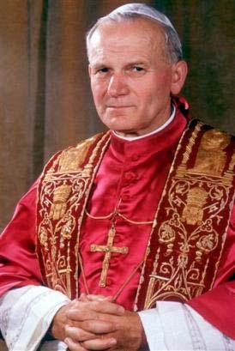
What does Blessed Pope John Paul II have to say?
“the treachery hidden within a development that is only quantitative, for the ‘excessive availability of every kind of material goods for the benefit of certain social groups, easily makes people slaves of “possession” and of immediate gratification.’” Victims of consumerism are caught up in the pursuit of false or superficial gratifications at the expense of experiencing their personhood in an authentic way. As a result, they experience a radical dissatisfaction, where the more they possess, the more they want, while their deeper aspirations remain unsatisfied and perhaps even stifled.

Slide 24
What does Catholic Social Teaching have to say?
If direct appeals are made to material and instinctive dimensions then “consumer attitudes and life styles can be created which are objectively improper and often damaging to physical and spiritual health”. (CA, 36)
The goal of Catholic Social Teaching is for lifestyles in which the quest for truth, beauty, goodness, and communion with others for the sake of the common good will determine consumers’ choices, savings, and investments. (CA, 36)

Slide 25
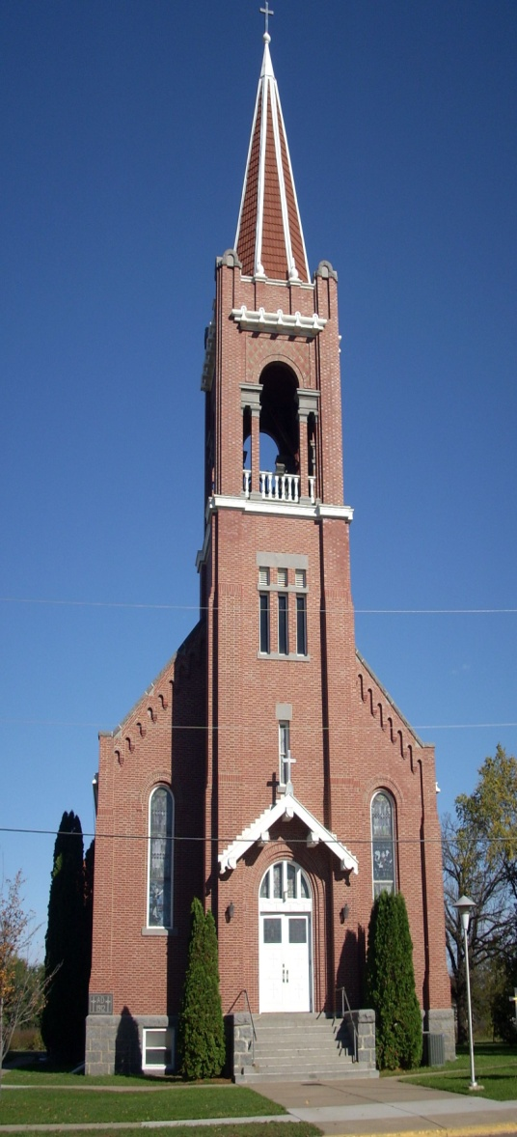
What does the Church have to say?
The Church opposes accumulation of wealth when others lack the basic necessities of life: “...there is a better understanding today that the mere accumulation of goods and services, even for the benefit of the majority, is not enough for the realization of human happiness.” (Sollicitudo Rei Socialis, 28)

Slide 26
What’s really important?????
List five significant events or key milestones in your life.
Share with a partner

Slide 27
Did the events involve family, friends, self achievement???
OR
Buying a new car

Slide 28
What do you want to be remembered for?????

Slide 29
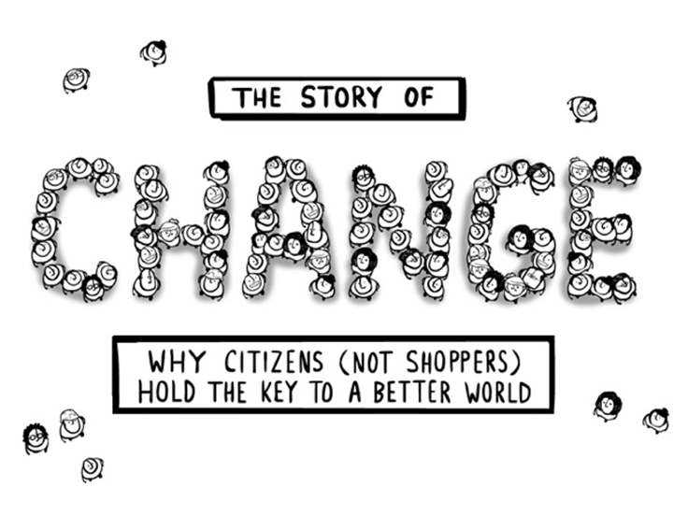
Make your life count!!!!!
You Tube:The Story of Change
Notes:
www.your-money-and-finance-.com/

Slide 30
Useful Websites
http://storyofstuff.org/
http://www.capp-usa.org/contemporary_issues/19
http://www.globalissues.org/issue/235/consumption-and-consumerism
http://www.afairerworld.org/_The_global_economy/consumerism.html
http://www.your-money-and-finance.com/consumerism.html
http://www.unesco.org/education/tlsf/mods/theme_c/mod18.html

Slide 31
http://parentclassroom.blogspot.com.au/2011/04/sbs-global-village.html
http://dazzling-dreams.net/index.php
http://spinneypress.com.au/books/consumerism/
http://aso.gov.au/education/society/consumerism/
http://www.goodreads.com/quotes/tag/consumerism
http://populationenvironmentresearch.org/papers/Lotze-Campen_Reusswig_Paper.pdf

