Slide 1
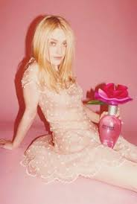

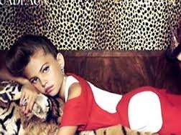
EDRE 623: Issues in the Teaching and Coordination of Religious Education
Social Research Project
Roseanne Caronna S00175134 Stephen Cartwright 8604111US

Slide 2

“The Sexualisation of Children and Adolescence through Advertising”
Sexualisation of children refers to the imposition of adult models of sexual behaviour and sexuality on to children and adolescents at developmentally inappropriate stages and in opposition to the healthy development of sexuality.
The Royal Australian and New Zealand College of Psychiatrists.
Position Statement # 58 2008
https://www.youtube.com/watch?v=hjAVL5zFrlU
Notes:
The sexualisation of children and adolescence occurs when:
“A person’s value comes only from his or her sexual appeal or behaviour, to the exclusion of other characteristics;
A person is held to a standard that equates physical attractiveness (narrowly defined) with being sexy;
A person is sexually objectified- that is, made into a thing for others’ sexual use, rather than seen as a person with the capacity for independent action and decision making; and/or
Sexuality is inappropriately imposed upon a person.”
(Report of the American Psychological Association Task Force on the Sexualisation of Girls, 2007, p2)

Slide 3
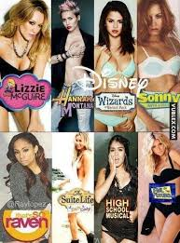

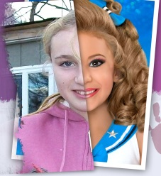
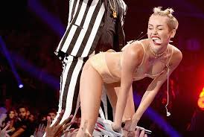
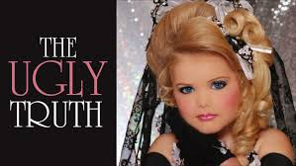
Where do we get these messages?
Corporate Paedophilia
Magazines
Television
Billboards
Movies
Music video clips
Music lyrics
Internet - Social Media
Advertisements
Beauty Pageants
Video games
Toys and Games
Notes:
These messages come from a variety of sources, that our children are continually exposed to.
Corporate Paedophilia is described as a metaphor for advertising and marketing that sexualises children for commerce (profit).

Slide 4
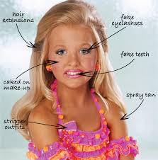
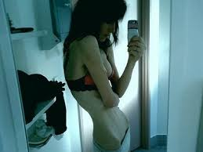


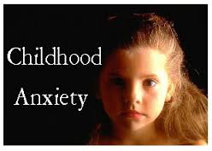
How does this affect our children?
http://www.abc.net.au/unleashed/37158.html
Notes:
There is widespread concern that children are often forced to psychologically and cognitively deal with sex and sexuality, long before they are developmentally ready.
Research shows that exposure to sexualised imagery is linked to children's experience of increased anxiety, depression, low self-esteem, body image problems, eating disorders, self harm, and sexually transmitted infections. Kids are also becoming sexually active at younger and younger ages.
http://www.abc.net.au/news/2008-03-03/37158

Slide 5

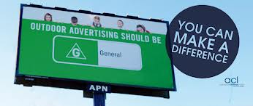
Significance of Sexualisation in today’s society
The AMA is calling for a new Inquiry into the premature sexualisation of children in marketing and advertising. (Australian Medical Association. 2012)
Background information:
In 2006, the Australian Institute published two discussions papers: Corporate Paedophilia: sexualisation of children in the media and Letting children be children: stopping the sexualisation of children in Australia. These caused major debate amongst all stakeholders.
As a result:
A Senate Inquiry into the sexualisation of children in the contemporary media environment, was conducted in 2008.
http://www.ccyp.vic.gov.au/childsafetycommissioner/downloads/submission_senateinquiry_media_sexn_of_kids.pdf
Notes:
Why have another Inquiry???
There is strong evidence that premature sexualisation of children is likely to be detrimental to child health and development, particularly in the areas of body and sexual health. (AMA President, Dr Steve Hambleton, 2012)
According to Dr Hambleton, the current self regulatory approach, through the Advertising Standards Bureau, is failing to protect children, and therefore is clearly not working.

Slide 6

Issued Covered in the Submission
Sexualisation
Exposure
Experiences of youth with media and advertising
Role of parents
Beneficiaries
Current regulatory failures
Reform approaches
Relevant contextual child development issues
Notes:
Due to the limited research in Australia on premature child sexualisation, there is a lack of data in relation to all aspects of this subject. This Senate Inquiry will presumably be the first step in a vital process of consultation, evidence building, and where a need is established, ultimately reform.

Slide 7
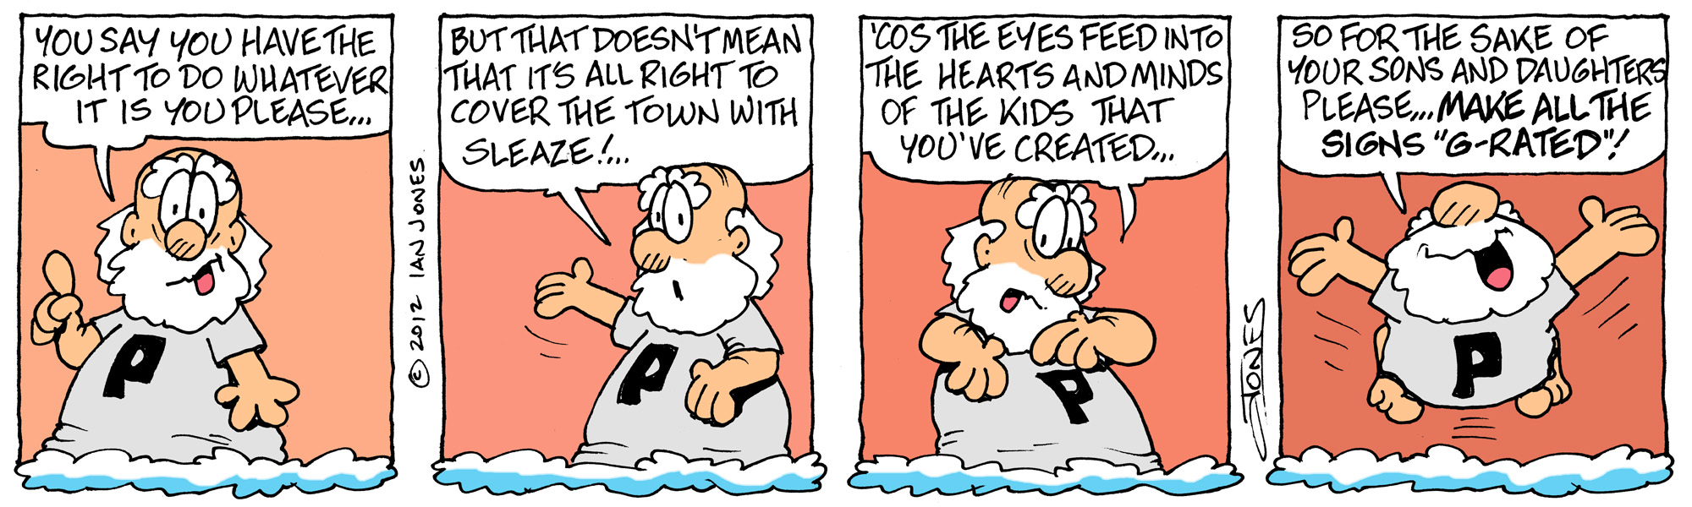
Information about sexualisation of children and adolescence through advertising?
https://www.youtube.com/watch?v=m4EF_RwA3Dw https://www.youtube.com/watch?v=zxCQLKdH4tU
https://www.youtube.com/watch?v=gaGqBpcT7Wc

Slide 8

Examples of Sexualisation
#Celebrities and Song Lyrics
The most common threat to our children is the celebrity exposure they witness via television and the internet. This being the teen stars they idolise especially those associated with Disney.
Hannah Montana went from wholesome family viewing into Miley Cyrus and the ‘twerking epidemic’- provocative dance moves that children mimic and praise.
https://www.youtube.com/watch?v=NgoyVRO0A0EL
Learning to twerk is simple via YouTube which has had over 4,000,000 views in 2014

Slide 9

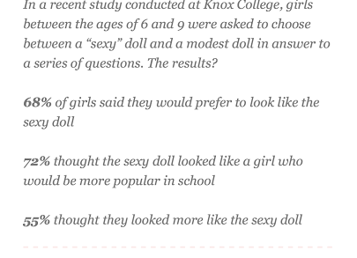
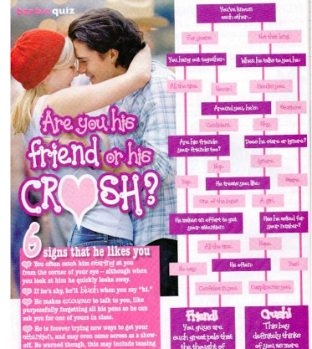
#Print Media and Body image
Excerpt from Barbie Magazine,
Market aged 6-13!
Child and teen magazines focus on adult themes of Style, Beauty, fashion and ‘crushes’ that use mature celebrities as their style icons.
Bratz and Barbie dolls pose unrealistic expectations of body image on young girls (See Statistics ABOVE)

Slide 10

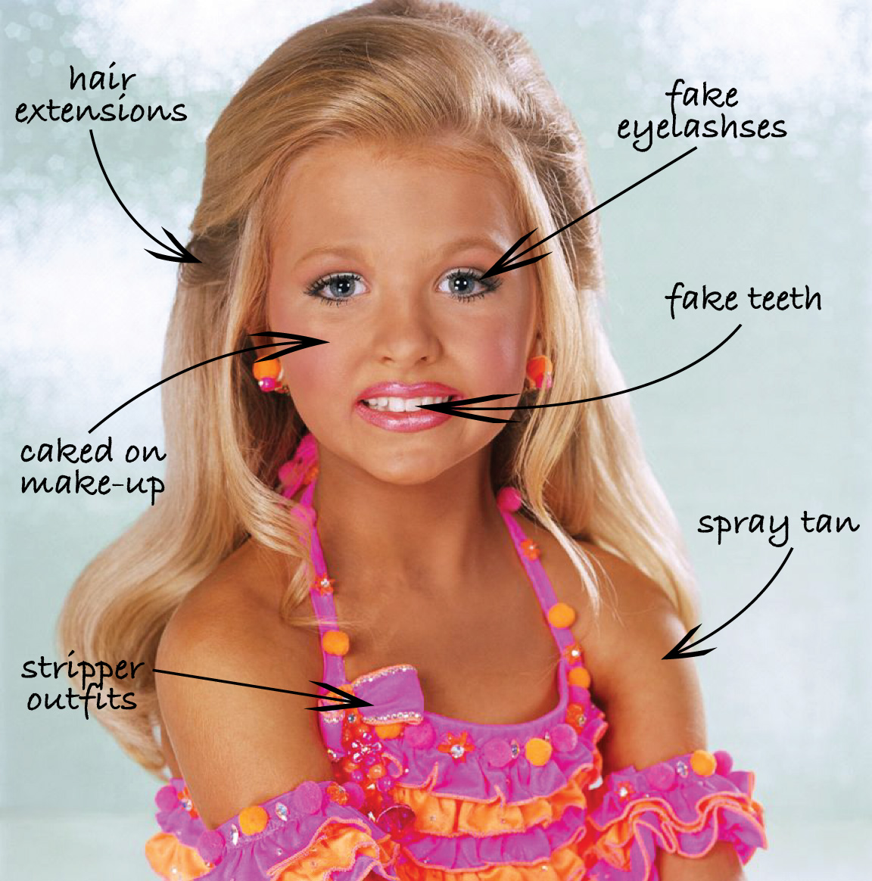
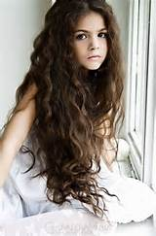
Innocence?
Adult poses
Does the idea that ‘sex sells’ relevant to the audience of children?
read more...
http://www.smh.com.au/federal-politics/political-opinion/sex-sells-but-were-selling-out-our-children-20120408-1wj7e.html

Slide 11



The Church and Other Perspectives
Anglicare- “Our children are being betrayed”
Children are being bombarded with images of sex and violence, dictating how they
are to behave and act through social and digital media.
Paul Mcdonald, Anglican Diocese of Melbourne, 2011
Life, Marriage and Family Centre-
“Sadistic and Pornographic Media”
The Inquiry into Australian Film and
Literature Classification Scheme, puts onus on
regulatory bodies for stricter classification and locks on
perverted media as it is too easily accessed by
children and not screened/ classified correctly. Programs
such as BIG Brother, air at times reasonable for most children.
Salvation Army- “Do Something!”
With reference to Genesis 1:27,the Salvos state that the image of the child is being tarnished as we were created in God’s likeness, hence what does this tell us about God if our children are exposed in this way? They urge to complain to media bodies if the representation of children in any form is noticed to be unjust.

Slide 12
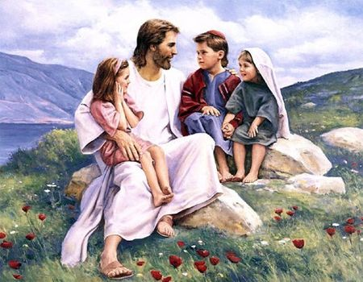
Perspectives cont...
Catholic Communications, Sydney Archdiocese- “Let Children be Children!”
There is a strong emphasis in following the U.K who has strict guidelines on it’s child fashion industry in ensuring children are not exposing their body in any provocative way. Childhood is a time of innocence and these ‘trends’ put unnecessary pressure on children to look older than their age.
Adults are entrusted with the role of ensuring this innocence and guiding them through Gospel values to love thy self.
It is in giving into these media trends, that we shift our focus from what God intended for creation, just as we lost our innocence in the Garden of Eden.

Slide 13


School and Class Initiatives
Educate Children and Parents
Children need Media Literacy skills to discern the propaganda and stereotypes placed before them. This literacy will form more critical analysts of the information presented before them.
Catholic Care- Assists teachers and parents in the language and education of personal development of young people as they grow and change. Do not shelter children, but rather promote mature dialogue and well-informed sexual education that is age appropriate to satisfy their learning needs during the critical time of change.
PDHPE programs such as the DET’s ‘Live, Life Well’ program, enables teachers with the resources to educate young children in healthy body image and lifestyles. A focus on sport and athletics, promotes outdoor and team activities that steer children away from violent toys and unrealistic dolls and television stereotypes. See more: http://www.curriculumsupport.education.nsw.gov.au/live_life/
Utilise the religious curriculum in the units of Love One Another and Breaking Down Barriers. These units emphasise the relationships we have with one another and how we see ourselves. Promote the values of the Gospel in order to steer children away from the propaganda of what they see on television.
Encourage children to take time to reflect and wonder so as to discern what they see in media and how they see themselves. This will promote healthy dialogue and support the mental health of our children.

Slide 14

What else can be done?
Model
Mentor children by promoting non-bias dialogue, giving praise for behaviour and product rather than appearance.
Select material that is suitable for the cohort and screen YouTube and any other media to ensure these are not adult and ensure child locks are secure on search engines.
Listen
Listen to children as they voice their concerns and be proactive in distracting adult dialogue by promoting children to be children through play and literature as well as positive praise. Voice any concerns to parents as they are the greatest asset in addressing this area.
Dinner time conversation is a valuable tool in speaking to young people about their day, discovering their ideas and addressing their concerns in a comfortable forum.
Be Proactive
Make a complaint if there is material or toys that you believe exploit the innocence of children. All advertising companies have offices in which complaints can be made and are addressed immediately to avoid detrimental reviews on their business. If no one voices their opinion, nothing will change.
Seek help if you believe a child is at risk of developing poor body image and unrealistic views of their age. Enrol them in sport and extra curricular that deter nonsense behaviour and speak to medical professionals if necessary.

Slide 15
References
Advertising media and exploitation of Chn-/ sexualisation and violence
Notion that "sex sells": http://www.smh.com.au/federal-politics/political-opinion/sex-sells-but-were-selling-out-our-children-20120408-1wj7e.html
Corporate Paedophilia
http://www.tai.org.au/documents/dp_fulltext/DP90.pdf
https://www.ranzcp.org/Files/Resources/58_ps-2008-pdf.aspx
http://www.ccyp.wa.gov.au/files/Sexualisation%20of%20Children%20and%20its%20Impact%20on%20their%20Wellbeing%20-%20A%20guide%20for%20parents,%20members%20of%20the%20community,%20media,%20advertisers%20and%20retailers.pdf
Church perspectives
http://www.parliament.qld.gov.au/documents/tableOffice/CommSubs/2013/outdooradv/036.pdf
http://www.lifemarriagefamily.org.au/files/submissions/Film%20and%20Literature%20Classification%20Scheme%20Mar%202011.pdf

